Slide 1

Marketing Plan (RATM)
Kitman Yiu
CIT185753
PROFESSIONAL PRACTICE 2
YUK (Eric) LAM

Slide 2
Executive Summary
Open World Games
GTA
Saint Row
Watchdog
Other Games
TheSims1,2,3,4

Slide 3
Introduction & Marketing Objectives 5%
Marketing objectives housed in the plan
A strategic context of the product
Why does shooting games can not win

Slide 4
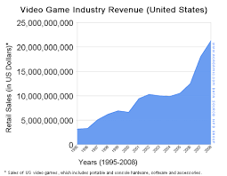
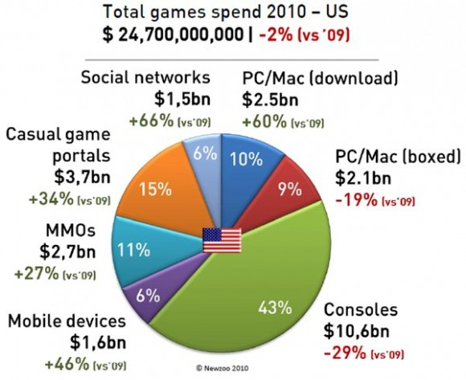
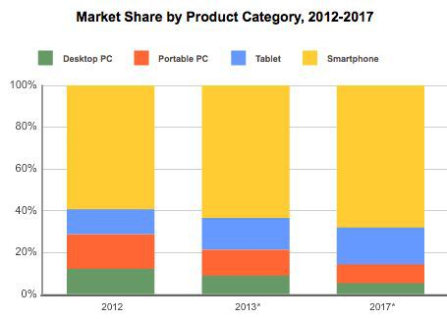
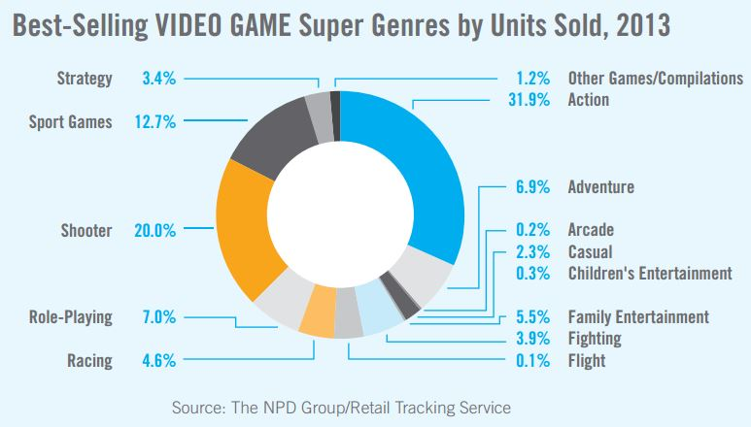
Background 5%
History
The Industry
Product
Type ?
Story ?
How to play?
What are the key people behind the development?
What are the Recent Changes in the market/s that the product interacts?

Slide 5
SITUATION ANALYSIS
Industry Analysis
Market size
Market potential
Noticeable past failures , notice new entries
Laws
Sales Analysis
How much do the other games sales in the market
 | GTA5 | Watch Dog | Saints Row IV
Development AND Market | US$266 Million
Copies | 52 Million | 9 Million | 1 million in the First week
Revenue | $1.669 billion, down from $2.414 billion | $611.3 million | unknown
Profit | $219.2 million, compared to $510.7 million | $21.6 million | unknown
Revenue from digitally delivered content | $616 million, up 42 percent | unknown | unknown
Competitive Analysis竞争分析
What are companies
What standout from other companies

Slide 6
SITUATION ANALYSIS 2
Customer Analysis 10%
What is the target of the market
What things will be change during the market
Why do you think the product is good for this company
Consumer Behaviour
Consumer decision making process
CONSUMER BEHAVIOUR
Needs, wants, values & Personality
Demographics
Information processing & decision making
Marketing Strategy
Regulatory Policy
Purchase & use behaviour
Evaluation & Selection
Information Search
Purchase location & Product choice
Problem Recognition
Post purchase Evaluation

Slide 7
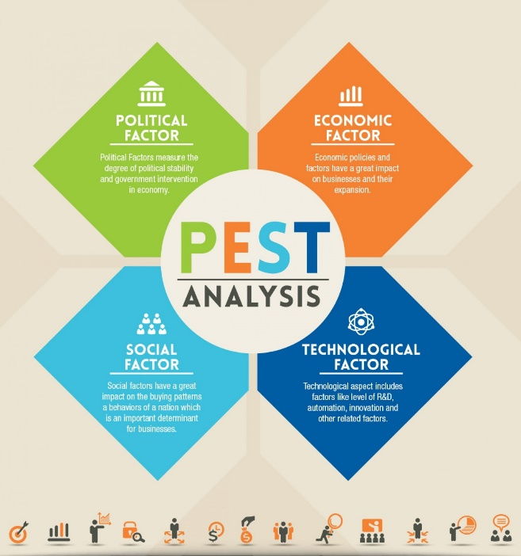
SITUATION ANALYSIS 2 15%
SWOT
Strengths
Weaknesses
Opportunities
Threats
PEST

Slide 8
OBJECTIVES
Corporate Objectives
How is the money going to use after receive the money
Marketing Objectives
How much are you going to sell

Slide 9
MARKETING PROGRAM
Marketing Mix(4P) 20%
Product?
Pricing?
Place?
Promotion?
Market Research
What information do we need to capture?
How can we make them do research?
Describe how market research information will be obtained, stored and updated ?

Slide 10
Time Frame
Introduction Phase
Growth Phase
Maturity
Phase
Decline
Phase
# of sales/ $ Revenue
Time

Slide 11
Conclusion 10%
The conclusion is in-depth,
factual and precise in its alignment to the major objectives and features of the plan including important timeline milestones and key elements of the marketing mix. It includes strategic and targeted recommendations, with extensive citations to increase the likelihood of success of the plan.

Slide 12
References
Marketing Mix (4Ps Analysis) - Google Search. 2015. Marketing Mix (4Ps Analysis) - Google Search. [ONLINE] Available at:https://www.google.com.au/search?q=Marketing+Mix+(4Ps+Analysis)&biw=1680&bih=965&tbm=isch&tbo=u&source=univ&sa=X&ei=rlRVVbmpGsHYmgXIvIHYDg&ved=0CDYQsAQ. [Accessed 25 May 2015].
Top Grossing iPhone Games, Installs, ARPU & revenue estimates - United States. 2015. Top Grossing iPhone Games, Installs, ARPU & revenue estimates - United States. [ONLINE] Available at:https://thinkgaming.com/app-sales-data/. [Accessed 25 May 2015].
Nielsen: majority of US app purchases are games, iOS users play twice as long. 2015. Nielsen: majority of US app purchases are games, iOS users play twice as long. [ONLINE] Available at:http://www.engadget.com/2011/07/07/nielsen-majority-of-us-app-purchases-are-games-ios-users-play/. [Accessed 25 May 2015].
Mobile gaming economy gets a boost from smartphone growth in emerging markets - Vserv. 2015. Mobile gaming economy gets a boost from smartphone growth in emerging markets - Vserv. [ONLINE] Available at:http://www.vserv.com/mobile-gaming-economy-gets-boost-smartphone-growth-emerging-markets/. [Accessed 25 May 2015].
14 brilliant examples of brands using interactive offline advertising | Econsultancy. 2015. 14 brilliant examples of brands using interactive offline advertising | Econsultancy. [ONLINE] Available at:https://econsultancy.com/blog/7165-14-brilliant-examples-of-brands-using-interactive-offline-advertising/. [Accessed 25 May 2015].
Solomon, Hughes, Chitty, Fripp, Marshall & Stuart: Marketing 2, Real People, Real Choices ©2011 Pearson Education Australia
VALS™ | VALS™ Types | SBI. 2015. VALS™ | VALS™ Types | SBI. [ONLINE] Available at:http://www.strategicbusinessinsights.com/vals/ustypes.shtml. [Accessed 25 May 2015].
Counter-Strike - Wikipedia, the free encyclopedia. 2015. Counter-Strike - Wikipedia, the free encyclopedia. [ONLINE] Available at:http://en.wikipedia.org/wiki/Counter-Strike. [Accessed 25 May 2015].
FNATIC.com: Counter-Strike is dying, now what? . 2015. FNATIC.com: Counter-Strike is dying, now what? . [ONLINE] Available at:http://www.fnatic.com/feature/8415/Counter-Strike-is-dying-now-what.html?cPage=2. [Accessed 25 May 2015].
A Competitive Analysis Example to Give You a Running Start. 2015. A Competitive Analysis Example to Give You a Running Start. [ONLINE] Available at: https://blog.udemy.com/competitive-analysis-example/. [Accessed 25 May 2015].
Grand Theft Auto 5 sells 45M copies, boosted by PS4 and Xbox One versions | Polygon. 2015. Grand Theft Auto 5 sells 45M copies, boosted by PS4 and Xbox One versions | Polygon. [ONLINE] Available at:http://www.polygon.com/2015/2/3/7973035/grand-theft-auto-5-sales-45-million-ps4-xbox-one. [Accessed 25 May 2015].
Watch Dog Ships 9 Million Copies, Helping Ubisoft Sales Rise Sharply - GameSpot. 2015. Watch Dog Ships 9 Million Copies, Helping Ubisoft Sales Rise Sharply - GameSpot. [ONLINE] Available at:http://www.gamespot.com/articles/watch-dog-ships-9-million-copies-helping-ubisoft-s/1100-6423279/. [Accessed 25 May 2015].
Game Database, Best Selling Video Games, Game Sales, Million Sellers, Top Selling - VGChartz. 2015. Game Database, Best Selling Video Games, Game Sales, Million Sellers, Top Selling - VGChartz. [ONLINE] Available at:http://www.vgchartz.com/gamedb/?name=watch+dogs&publisher=&platform=&genre=&minSales=0&results=200. [Accessed 25 May 2015].
Google. 2015. Google. [ONLINE] Available at: https://www.google.com.au/?gws_rd=ssl#q=first+open+world+game+. [Accessed 25 May 2015].
Top 10 Embarrassingly bad moments in Videogame Marketing. 2015. Top 10 Embarrassingly bad moments in Videogame Marketing. [ONLINE] Available at: http://calmdowntom.com/2011/03/top-10-embarrassingly-bad-moments-in-videogame-marketing/. [Accessed 25 May 2015].
Product and brand failures: a marketing perspective - Marketing Plan Help & Marketing Advice - Mplans. 2015. Product and brand failures: a marketing perspective - Marketing Plan Help & Marketing Advice - Mplans. [ONLINE] Available at: http://www.mplans.com/articles/product-and-brand-failures-a-marketing-perspective/. [Accessed 25 May 2015].

